Slide 1
The Effects of Red on Test Anxiety: Does the Color of a Proctor’s Shirt Affect Intellectual Performance?
Trisha Barton
Dr. Amy Copeland, Ph.D, M.P.
Department of Psychology
Louisiana State University
Pre-Doctoral Scholars Institute
Research Symposium
June 26, 2015

Slide 2
Research Questions
Does red affect anxiety levels in different test anxious people?
Can a test proctor's red color shirt affect intellectual performance differently among test anxious types?

Slide 3
Purpose
Add to color research
Already known
Warm colors increase arousal and cool colors decrease arousal
Red emphasizes detail and caution (Mehta & Zhu, 2009)
Blue helps foster creativity (Mehta & Zhu, 2009)
Color associations are learned (conditioning) and innate (evolutionary reasons) (Elliot, Maier, Moller, Friedman, & Meinhardt , 2007)
To understand red for proper application
Education settings
Standardize tests
To maximize beneficial environments to decrease elements that trigger test anxiety

Slide 4
The Problem
Color research
There are still many questions on color application and context
Test Anxiety (TA)
20-30% of undergraduate students are affected
2 out of 3 students are highly test anxious
Test anxiety negatively affects performance
Test anxiety increases with academic achievement
TA affects more women than men
Solution
Maximize learning skills by understanding environments that affect testing and learning
Research colors in context

Slide 5
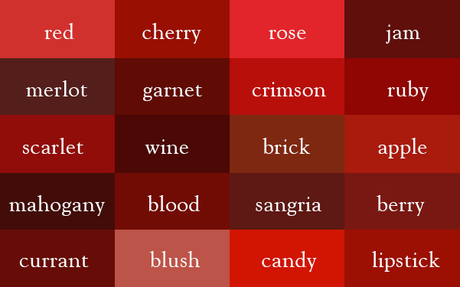
Research on Red
Important Articles
Elliot et al. , 2007
test Yerkes & Dodson Law (1908)
red directly affecting performance and not mood, perceptions, or appraisals
Participants were unaware of study interest in red and avoidance motivation
Lichtenfeld, Maier, Elliot, & Pekrun, 2009
worry, and not general arousal or mood, mediate the semantic red affect by 95%
Those who worried the most, performed the worst
slight difference in performance between men and women
participants were unaware of study focus on color words with intellectual performance
Tanaka & Tukuno, 2011
color (red, green, & white) affected task choice between easy and difficult tasks
red triggers avoidance motivation was proven
unaware that the study focused on color and performance

Slide 6
Research on Test Anxiety
Definition
feelings of tension, apprehension, worrisome thoughts
Components
Cognitive
Affective
Behavioral
Test anxiety & performance are negatively correlated by r=.-21(Chapell et al., 2005; Handelzalts & Keinan, 2010; Seipp, 1991)
Best treatments
combined therapies and skilled focused approaches (Ergene, 2003)
Behavioral and cognitive techniques(Ergene, 2003)
Practice is associated with effectiveness (Ergene, 2003)

Slide 7
Effects of Red and Test Anxiety
Bargh’s law (1990)
Goldstein’s work in 1942 suggested that “the body has inherent physiological reactions to color that are reflected in psychological experience and functioning” (Elliot et al., 2007; Goldstein, 1942; ; Stone & English, 1998)
Yerkes-Dodson’s law (1908)
Inverted U Hypothesis
Complex Task → low arousal
Simple Task → high arousal
Worry
Test anxiety → worry is the mediator that affects concentration
Red → worry has been suggested to be the mediator in affecting performance (Lichtenfeld et al. , 2009)

Slide 8
Hypotheses
Main Effect 1: It is hypothesized for color, that when participants are exposed to the proctor wearing a red shirt will report higher levels of anxiety as compared to those exposed to the first test with a proctor in the white shirt
Main Effect 2: It is hypothesized for anxiety level, that those participants high in anxiety will show poorer overall performance on the IQ test as compared to low anxiety participants
Interaction: It is hypothesized that color by anxiety level interaction, whereby participants with high test anxiety when exposed to the proctor wearing the red shirt will perform particularly poorly on the IQ test.

Slide 9
Methods

Slide 10
participants
18-24 undergraduate students from a large university
Already enrolled in Math 101 class

Slide 11
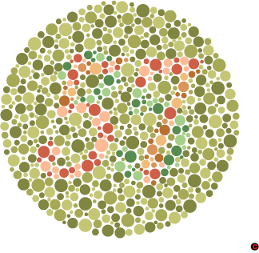
Materials/Measures
Proctor Shirt Color
Spielberger Test Anxiety Inventory (TAI)
Spielberger State Trait Anxiety Inventory (STAI)
Ishiara color blindness
The demographic questionnaire
Intelligence Structure Test

Slide 12
Procedure
Sign-Up for participation
Collect demographics, Ishiara color blindness, & assess anxious type
First Test (only participants):
Proctor: White Shirt
Reads instructions and passes out warm up (IQ test)
After test take STAI
Second Test (only participants):
Proctor: Red shirt
Reads instructions and passes out warm up (IQ test)
After test take STAI

Slide 13
Data Analysis
2x2 factorial analyses of variance (ANOVA) design
Factor variables:
color (red and white)
test anxious type (low test anxious and high test anxious)
Response Variable:
Hypothesis one: test anxiety type
Hypothesis two: IQ test score for 10-items

Slide 14
References
Adaa.org. (2015). Test anxiety. Anxiety and Depression Association of America, ADAA. Retrieved 22 April 2015, from http://www.adaa.org/living-with-anxiety/children/test-anxiety.
Block, T., Pandelaere, M., & Kenhove, P.V. (2012). When colors backfire: The impact of color cues on moral judgment. Journal of Consumer Psychology, 23(3), 341-348.
Bargh, J. A. (1990). Auto-motives: preconscious determinants of social interaction, Handbook of Motivation and Cognition, 2, 93-130
Chapell, M., Blanding, B., Silverstein, M., Takahashi, M., Newman, B., Gubi, A., McCann, N. (2005). Test anxiety and academic performance in undergraduate and graduate students. Journal of Educational Psychology, 97(2), 268-274
Curry, N., & Kasser, T. (2005). Can coloring mandalas reduce anxiety? Art Therapy: Journal of the American Art Therapy Association, 22 (2), 81-85. Retrieved February 17, 2015.
Ishihara 38 Plates CVD Test (2014). In Colorblindor. Retrieved June 20, 2015, from http://www.color-blindness.com/ishihara-38-plates-cvd-test/
Damer, D. & Melendres, L. (2011). Tackling test anxiety: A group for college students. The Journal for Specialists in Group Work. 36(3), 163-177.
DiRocco, D. (2012). The effect of the color red on test anxiety. Unpublished manuscript, Department of Honors Psychology, Lycoming College, Williamsport, PA.
Driscoll, R. (2007). Westside Test Anxiety Scale Validation. Education Resources Information Center, 6.

Slide 15
References (cont.)
Driscoll, R. (2004). Westside Test Anxiety Scale [Measurement Instrument]. Retrieved from http://www.amtaa.org/scalewest.html
Elliot, A. J., & Maier, M. A. (2014). Color and psychological functioning. Current Directions in Psychological Science, 250-254.
Elliot, A. J., & Maier, M. A. (2012). Color psychology: Effects of perceiving color on psychological functioning in humans. The Journal of Socio-Economics, 738-745.
Elliot, A. J., Maier, M.A., Moller, A. C., Friedman, R., & Meinhardt, J. (2007). Color and Psychological functioning: The effect of red on performance attainment. Journal of Experimental Psychology: General, 136(1), 154-168.
Hamilton, J. (2009, February 6). Personal interview with Markus Maier, Ravi Mehta, and Nancy Stone. http://www.npr.org/templates/story/story.php?storyId=100301582
Handelzalts, J. & Keinan, G. (2010). The effect of choice between test anxiety treatment options on treatment outcomes. Psychotherapy Research, 20(1), 100-112.
Lichtenfeld, S., Marier, M., Elliot, Pekrun, R. (2009). The Semantic red effect: Processing the word red undermines intellectual performance. Journal of Experimental Social Psychology, 45, 1273-1276.
Mehta, R. & Zhu, R. (2009). Blue or red? Exploring the effect of color on cognitive task performances. American Association for the Advancement of Science, 323(5918), 1226-1229
Payen,V., Elliot, A., Coombes,S., Chalabaev, A., Brisswalter, J., & Cury, F.. (2011). Viewing red prior to strength test inhibits motor output. Neuroscience Letters, 495, 44-48.
Putwain, D. (2008). Examination stress and test anxiety. British Psychological Society, 21(12), 1026-1029.

Slide 16
References (cont.)
Segool, N., von der Embse, N., Mata, A., &Gallant. (2013). Cognitive behavioral model of test axniety in a high-stakes context: An exploratory study. School Mental Health.
Speilberger, C. (1977). State Trait Anxiety Inventory [Measurement Instrument]. Retrieved from http://yogabharati.org/public_download/Yoga_SN_2014/State_Trait_Anxiety_Inventory_for_adults.pdf
Stone, N.J. (2001). Designing effective study environments. Journal of Environmental Psychology, 21, 179-190.
Stone, N.J. & English, A.J. (1998). Task type, posters, and workspace color on mood, satisfaction, and performance. Journal of Environmental Psychology, 18, 175-185.
Tanaka, A., Tokuno, Y. (2011). The effect of the color red on avoidance motivation. Social Behavior & Personality: An International Journal, 39(2), 287-288.
Williams, J.M., Landers, D.M., Boutcher, S.H., (1993). Arousal-performance relationships, applied sport psychology; personal growth to peak performance. 2, 170-184

Slide 17
Questions/Comments

